Slide 1
Quantitative Foundations
Project 1
Linear Feature Engineering
Presented by
Ayush Kumar Shah (as1211@rit.edu)
Akib Shahriyar (as8751@rit.edu)

Slide 2
Overview
1
Introduction
2
Data Analysis
3
Feature Selection
4
Dealing with Overfitting
5
Results and Discussion
6
Conclusion

Slide 3
Overview
Introduction
1
Introduction
Tasks performed in the project
2
Data Analysis
3
Feature Selection
4
Dealing with Overfitting
5
Results and Discussion
6
Conclusion

Slide 4
Introduction
Tasks performed:
Data Analysis
Linear Regression
Feature Engineering
Polynomial selection
Various custom functions selection
Automation of model selection
Overfitting reduction using 10-fold Cross Validation

Slide 5
Overview
Data Analysis
1
Introduction
Correlation plots
Visualization using PCA
2
Data Analysis
3
Feature Selection
4
Dealing with Overfitting
5
Results and Discussion
6
Conclusion

Slide 6
Data Analysis
Analyzed the training data to understand the relationship between the attributes and the target.
Dataset: 926 training samples and 103 test samples.
Each Training sample: 8 attributes and 1 target value.
Each Test sample: 8 attributes (without target value).
Performed the following analysis:
Kendall’s Correlation Coefficients matrix
Correlation plots between input features and target
Principal Component Analysis (PCA)

Slide 7
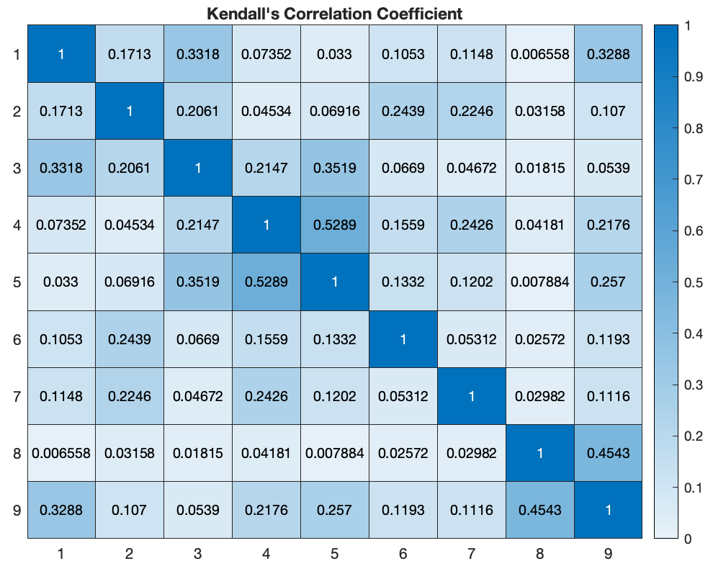
Data Analysis
Figure 1: Kendall’s Correlation Coefficient Matrix

Slide 8
Data Analysis
The third feature had very low correlation with the target (-0.05).
However, after removing the third feature, the cross validation error increased from 51.664 to 53.728.
So, all eight features are important in the dataset.
Minimal benefit due to the lack of domain knowledge.
Notes:
Figure (a): A matrix of scatter plots and histograms of the data. Each off-diagonal plot in the resulting figure is a scatter plot of a column of data against another column of data. It also plots the distribution of each column in the diagonal plots of the plot matrix.

Slide 9
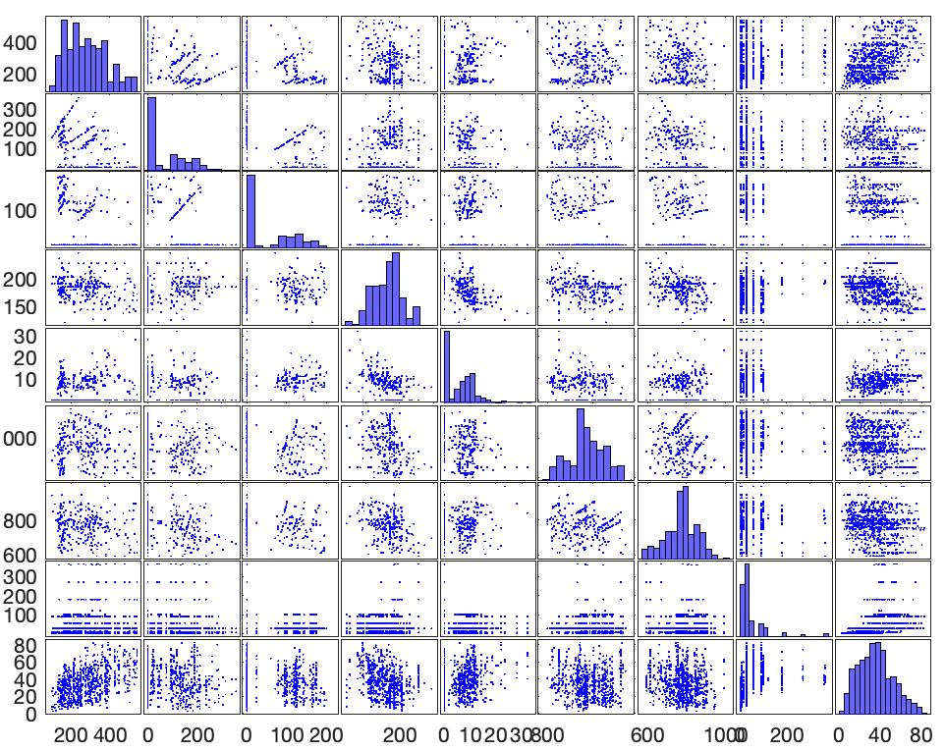
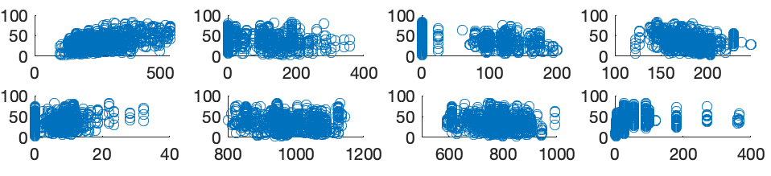
Data Analysis
Figure (b): Correlation between input features and target
Figure (a): Correlation among all features
Figure 2: Feature Correlation plots
Notes:
Figure (a): A matrix of scatter plots and histograms of the data. Each off-diagonal plot in the resulting figure is a scatter plot of a column of data against another column of data. It also plots the distribution of each column in the diagonal plots of the plot matrix.
Figure (b): Scatter plots between each input feature and the target feature.

Slide 10
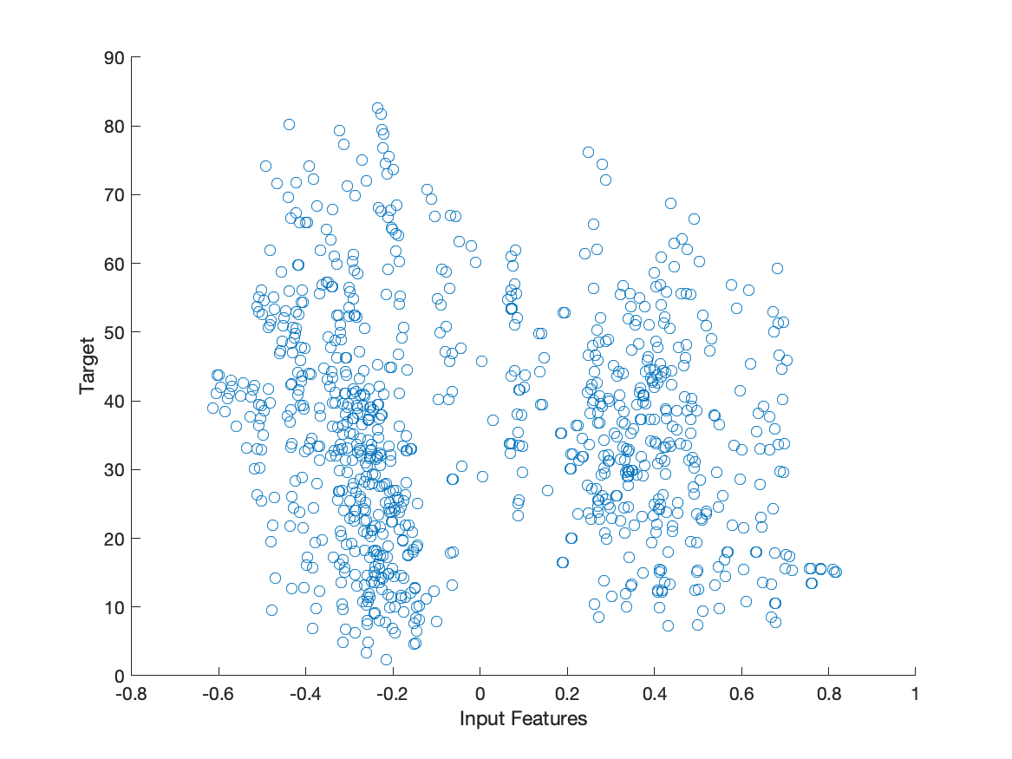
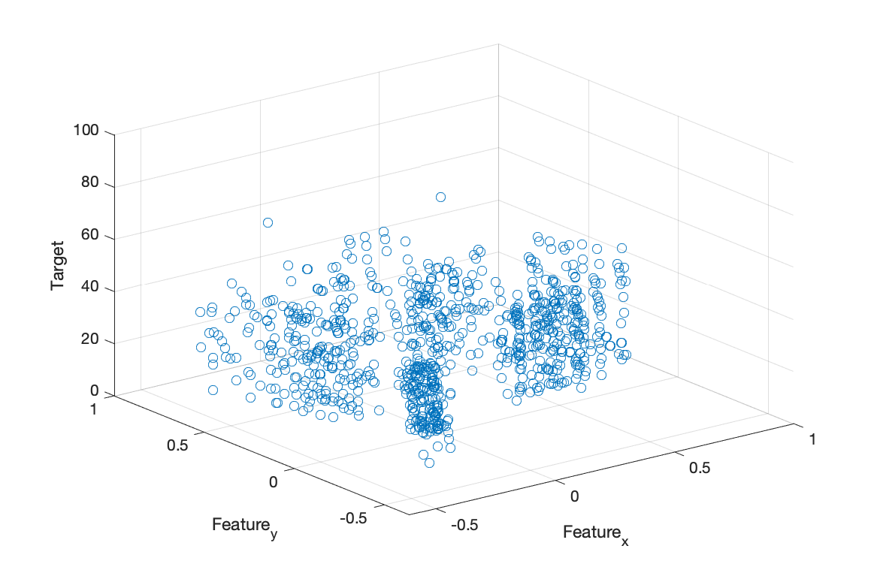
Data Analysis
a) 3D scatter plot
b) 2D scatter plot
Figure 3: Data Visualization using PCA

Slide 11
Overview
Feature Selection
1
Introduction
Functions
Polynomial functions
Fractional powers
Negative powers
Logarithmic functions
Trigonometric functions
Automation of model selection
2
Data Analysis
3
Feature Selection
4
Dealing with Overfitting
5
Results and Discussion
6
Conclusion

Slide 12
Feature Selection
Multiple functions were tested to find the best model to fit the data.
Polynomial functions of orders 0 to 10.
Functions with fractional powers of input features: 1/10 to 9/10.
Functions with negative powers and log.
Trigonometric functions.
K-Fold cross-validation (K=10) used for selecting the best function.

Slide 13
Feature Selection
create_custom_models.m
models('Z_01') = [ X.^2; X.^3; X.^0.1; X.^0.2; X.^0.3; X.^0.4; X.^0.5; X.^0.6; X.^0.7; ones(1, N)];
models('Z_02') = [ X; X.^2; X.^3; X.^0.1; X.^0.2; ones(1, N)];
models('Z_03') = [ X.^2; X.^3; X.^0.1; X.^0.2; ones(1, N)];
models('Z_04') = [ones(1, N); sin(X); cos(X)];
models('Z_05') = [sin(X).^2; cos(X).^2; ones(1, N) ];
models('Z_06') = [X; X.^2; X.^3; ones(1, N); sin(X); cos(X)];
models('Z_07') = [X.^2; X.^3; X.^0.1; X.^0.2; ones(1, N); sin(X)];
models('Z_08') = [X; X.^2; X.^3; X.^4; ones(1, N); sin(X); cos(X)];
models('Z_09') = [ X.^2; X.^3; X.^0.1; X.^0.2; ones(1, N); sin(X); cos(X)];
models('Z_10') = [ X.^2; X.^3; X.^0.1; X.^0.2; ones(1, N); sin(X); cos(X); tan(X)];
models('Z_11') = [ X.^2; X.^3; X.^0.1; X.^0.2; X.^0.5; ones(1, N); sin(X); cos(X); tan(X)];
models('Z_12') = [X.^-1; ones(1, N)];
models('Z_13') = [X.^-1; X.^-2; ones(1, N)];
models('Z_14') = [log10(X); ones(1, N)];
models('Z_15') = [X; X.^2; X.^3; log10(X); ones(1, N)];
models('Z_16') = [X; X.^2; X.^3; X.^-1; ones(1, N)];

Slide 14
Feature Selection
Step 1: Best polynomial model selected on training data.
Step 2: Custom models added and evaluated on training data.
Step 3: Final best model selected among best polynomial and custom functions.
Model fitted using least squares method.
Automation of best model selection performed.
Based on least validation error in K-fold cross validation step.

Slide 15
Overview
Dealing with Overfitting
1
Introduction
K-fold cross validation
2
Data Analysis
3
Feature Selection
4
Dealing with Overfitting
5
Results and Discussion
6
Conclusion

Slide 16
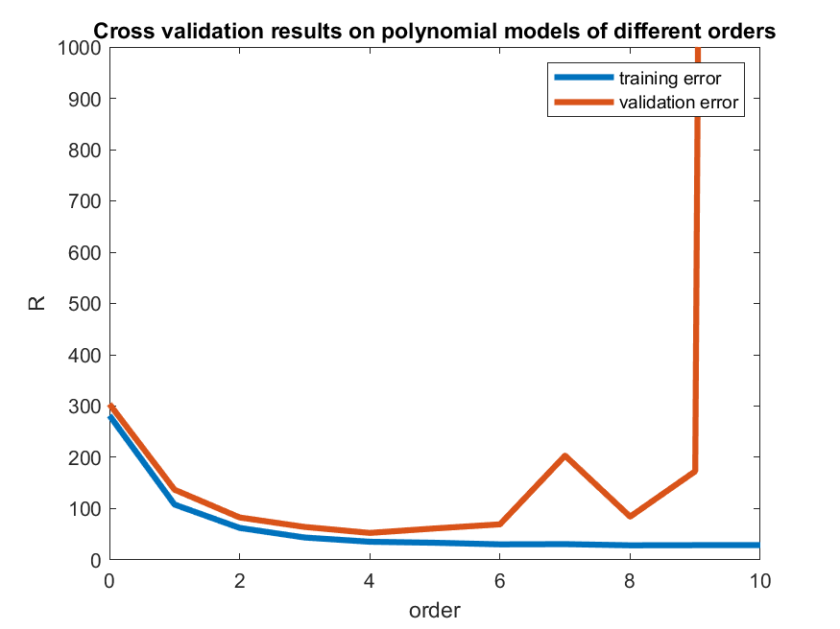
Dealing with Overfitting
K-fold cross-validation implemented to select the best model.
Features divided into non-overlapping training and validation sets.
Training on features created from the training set.
Testing on features built from the unseen validation set.
Hence, overfitting was reduced.
Notes:
As all the features follow the same distribution, features were divided into non-overlapping training and validation sets.
Since validation errors were calculated on the features not seen by the model during training, overfitting was reduced.

Slide 17
Overview
Results and Discussion
1
Introduction
Polynomial functions
Overall results
Final Errors
2
Data Analysis
3
Feature Selection
4
Dealing with Overfitting
5
Results and Discussion
6
Conclusion

Slide 18
Results and Discussion
Running the main function
>> y_pred = get_predictions(); % OR
>> y_pred = get_predictions(0:10, 10);
The code runs the training on the training data by calling the train() function.
Selects the best model with least validation error automatically using K-fold cross validation.
Reads the test data.
Calculates the predictions on test data using the trained model.
Writes the prediction to the file predictions.txt.

Slide 19
Results and Discussion: Polynomial functions
Orders | R_train | R_val
0 | 281.69 | 303.95
1 | 108.02 | 137.02
2 | 62.48 | 82.855
3 | 43.757 | 64.327
4 | 35.496 | 52.742*
5 | 33.541 | 61.466
6 | 30.428 | 69.468
7 | 30.856 | 203.35
8 | 28.564 | 84.398
9 | 28.872 | 172.92
10 | 28.984 | 19813

Slide 20
Results and Discussion: Overall
Models | R_train | R_val
Z_03 | 32.551 | 51.664*
Z_09 | 30.73 | 52.31
Polynomial of order 4 | 35.496 | 52.742
Z_07 | 31.856 | 53.11
Z_08 | 33.718 | 55.084
Z_02 | 32.408 | 56.069
Z_10 | 29.972 | 57.128
Z_11 | 29.646 | 59.613
models('Z_03') = [X.^2; X.^3; X.^0.1; X.^0.2; ones(1, N)];
models('Z_09') = [X.^2; X.^3; X.^0.1; X.^0.2; ones(1, N); sin(X); cos(X)];
models('Z_07') = [X.^2; X.^3; X.^0.1; X.^0.2; ones(1, N); sin(X)];
models('Z_08') = [X; X.^2; X.^3; X.^4; ones(1, N); sin(X); cos(X)];
models('Z_02') = [X; X.^2; X.^3; X.^0.1; X.^0.2;
ones(1, N)];
models('Z_10') = [X.^2; X.^3; X.^0.1; X.^0.2; ones(1, N); sin(X); cos(X); tan(X)];
models('Z_11') = [X.^2; X.^3; X.^0.1; X.^0.2; X.^0.5; ones(1, N); sin(X); cos(X); tan(X)];

Slide 21
Results and Discussion: Overall
Models | R_train | R_val
Z_06 | 41.181 | 64.841
Z_04 | 221.72 | 278.85
Z_05 | 258.52 | 305.1
Z_01 | 68.538 | 371.08
Z_12 | NaN | NaN
Z_13 | NaN | NaN
Z_14 | NaN | NaN
Z_15 | NaN | NaN
Z_16 | NaN | NaN
models('Z_06') = [X; X.^2; X.^3; ones(1, N); sin(X); cos(X)];
models('Z_04') = [ones(1, N); sin(X); cos(X)];
models('Z_05') = [sin(X).^2; cos(X).^2; ones(1, N) ];
models('Z_01') = [X.^2; X.^3; X.^0.1; X.^0.2; X.^0.3; X.^0.4; X.^0.5; X.^0.6; X.^0.7;
ones(1, N)];
models('Z_12') = [X.^-1; ones(1, N)];
models('Z_13') = [X.^-1; X.^-2; ones(1, N)];
models('Z_14') = [log10(X); ones(1, N)];
models('Z_15') = [X; X.^2; X.^3; log10(X); ones(1, N)];
models('Z_16') = [X; X.^2; X.^3; X.^-1; ones(1, N)];

Slide 22
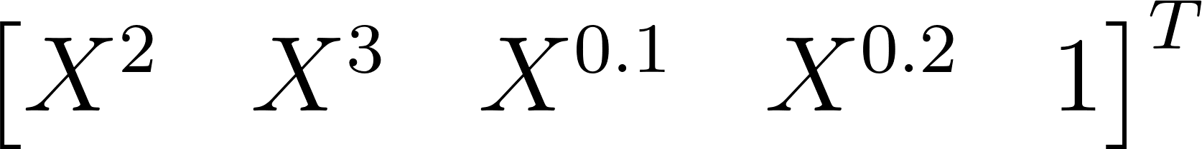
Results and Discussion
4th order polynomial function had the least validation error among the polynomials.
Fractional powers reduced the validation error.
Functions with negative powers and log failed (Error: NaN).
sin() and cos() functions also resulted in a low validation error.
Final selected Function:

Slide 23
Results and Discussion
Final training done on the whole data using the best model.
Best Test MSE error predicted:
Best Train MSE error achieved:
51.664
33.211
Test Mean absolute error predicted: 7.18
Range of target values: 80.27
Overall, the model is a good approximation since the predicted test mean absolute error is within 10% of the range of target values (Y).

Slide 24
Overview
Conclusion
1
Introduction
Key Takeaways
2
Data Analysis
3
Feature Selection
4
Dealing with Overfitting
5
Results and Discussion
6
Conclusion

Slide 25
Conclusion
Implemented Linear Regression from scratch in MATLAB.
Performed Feature Engineering on given dataset.
Experimented with multiple models based on non-linear functions.
Automated model selection based on validation error.
Successfully leveraged K-fold cross validation to reduce overfitting.
The project can be improved by using more complex models and overfitting reduction techniques like regularization.

Slide 26


Slide 27

Questions?

